Slide 1
IOT BASED SAFETY KIT FOR CONSTRUCTION WORKERS
Batch 18
PROJECT GUIDE:
Mrs.R.Devi.,B.Tech.,M.E.,
Assistant Professor(Grade 1),
Department of CSE.
TEAM MEMBERS:
Jenifer.S -211417104096
Sameera.H-211417104233
Sudharshna.U-211417104273

Slide 2
ABSTRACT
According to a study by the Indian Institute of Technology (IIT), around 48,000 workers die in India every year due to occupational accidents which is approximately equal to 38 fatal accidents everyday. India has a total population of 138 crore and a total workforce of 46.5 crore, so a total of approximately 46 crore people are in need of a solution to this grave danger which they face every day. There are no products designed at present to help reduce the number of deaths in the construction field, so our product will be one in a kind. A handy IOT based safety kit is designed for the construction workers. Each kit has a unique ID, and is to be worn at all times by the workers, when they are on – site. If an accident occurs on the site causing the user to get stuck between a mass of debris, this kit will be instrumental in the rescue process.

Slide 3
Literature Review
YEAR /JOURNAL NAME | TITLE | AUTHORS | DESCRIPTION | ADVANTAGES | DISADVANTAGES
2018 International Journal of Engineering Research & Technology (IJERT) | IOT based Smart Helmet for Ensuring Safety in Industries. | Mangala Nandhini. V , Padma Priya G.V , Nandhini. S, Mr. K.Dinesh. | The proposed system provides real time monitoring of harmful gases like CO , CH4 , LPG , temperature and humidity. To overcome those hazardous situation, this system provides emergency alert to the monitoring station . | All real time data are received from helmet to the monitoring station through Wi-Fi and can be visualized on the Thingspeak application in the form of graphical charts. | The parameters measured are sent to wireless communication module by the micro- controller. The collected information is sent to long-distance monitoring centre by cable. So the reliability and long life of conventional communication system is poor.

Slide 4
Literature Review (Contd.)
YEAR / JOURNAL NAME | TITLE | AUTHORS | DESCRIPTION | ADVANTAGES | DISADVANTAGES
2017 Interanational Journal of Advance Research in Science and Engineering | ZIGBEE BASED INTELLIGENT HELMET FOR COAL MINERS | Pulishetty Prasad, Dr.K. Hemachandran, H.Raghupathi. | The system Is a value powerful ZigBee-primarily based wireless mine supervising system. It finds out actual-time surveillance with early-warning intelligence on temperature, leakage of gas in mining place, and alerting the control station the usage of wireless zigbee technology. | Unlike Bluetooth or wireless USB gadgets, ZigBee devices have the capability to shape a mesh community among nodes. This technique allows the quick range of an person node to be accelerated and improved, covering a far larger region. | This system devises a smart helmet using Zigbee technology for monitoring the emission of hazardous gases, abnormal temperature conditions, humidity levels etc. This system ensures safety for workers at the mining area but this helmet is not purposely provided for the safety of the workers.

Slide 5
Literature Review (Contd.)
YEAR / JOURNAL NAME | TITLE | AUTHORS | DESCRIPTION | ADVANTAGES | DISADVANTAGES
2018 International Journal of Engineering Research in Computer Science and Engineering (IJERCSE) | ‘SIRASTRANA’ A Smart Helmet for Air Quality and Hazardous Event Detection for the Mining Industry | Raghavendra Rao B, Karthik NS, NA Poojitha, Divya L, Nandini N | In the proposed system the accelerometer detects miners when they get struck by an object against the head with a force exceeding a value of 1000 on the HIC (Head Injury Criteria). | This system consists of a special feature -Helmet Removal Sensor it alerts when the worker has removed the helmet during working hours. | This system only concentrates on protecting the miner’s head against potential hazardous bumps. But it does not provide any safety measures to overcome in case of any emergency conditions.

Slide 6
Literature Review(Contd.)
YEAR/ JOURNAL NAME | TITLE | AUTHORS | DESCRIPTION | ADVANTAGES | DISADVANTAGES
2017 International Journal of Advanced Research in Computer and Communication Engineering | A SMART HELMET FOR IMPROVING SAFETY IN MINING INDUSTRY | Mrs.A.DHANALAKSHMI, P.LATHAPRIYA, K.DIVYA. | In event of poisonous gas detection the helmet opening gets closed and the oxygen supply is provided within the helmet for the miners by the opening of solenoid valve of the oxygen cylinder. | This project aims at designing a smart helmet for hazardous event detection, monitoring and providing oxygen supplements to avoid the inhalation of poisonous gases | The helmet is too heavy since it contains oxygen cylinders which is uncomfortable to work with. The miners tend to remove the helmet off their head.

Slide 7
Literature Review(Contd.)
YEAR/ JOURNAL NAME | TITLE | AUTHORS | DESCRIPTION | ADVANTAGES | DISADVANTAGES
2020 International Journal of Advanced Science and Technology | Hard Hat Detection Using Deep Learning Techniques | C. Jagadeeswari, Nagamani.G, Sneha.B and Dr. G. NagaSatish | This system intelligently identifies whether the worker is bears hard hat or not using YOLO algorithm which is much faster algorithm in object identification. | Head is the most critical part of a human body and is highly vulnerable to any impact that is caused due to serious injuries. Using protective hard hat in construction/industrial areas is highly recommended. | This system is used to detect only whether the worker is wearing the hat during working. But it does not provide any safety measures to overcome in case of any emergency conditions.

Slide 8
Literature Review (Contd.)
YEAR /JOURNAL NAME | TITLE | AUTHORS | DESCRIPTION | ADVANTAGES | DISADVANTAGES
2017 MDPI Journal Publication. | Highly Portable, Sensor-Based System for Human Fall Monitoring | Aihua Mao, Xuedong Ma, Yinan He and Jie Luo. | This system propose a human fall monitoring system consisting of a highly portable sensor unit including a triaxis accelerometer, a triaxis magnetometer, and a mobile phone. With the data from these sensors, system obtains the acceleration and Euler angle (yaw, pitch, and roll), which represents the orientation of the user’s body. | Falls are a very dangerous situation especially among elderly people, because they may lead to fractures, concussion, and other injuries this system helps in fall detection and help in daily life of elders. | This system is particularly used for detecting safety for elderly people but not for the workers.

Slide 9
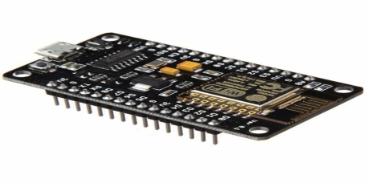
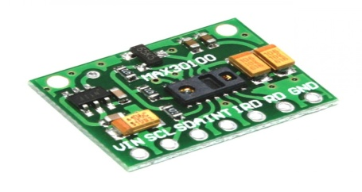
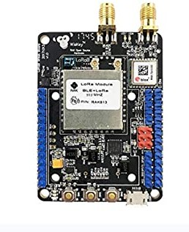
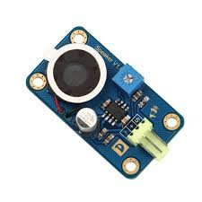

Technology Stack
HARDWARE COMPONENT
SPO2 SENSOR
ESP8266 BOARD
LOCATION TRACKER(bluetooth)
SPEAKER
ADX –AVERAGE DIRECTIONAL INDEX
(SENSOR-MPU6050)
6) LM35 (temperature)
SOFTWARE COMPONENT
FIREBASE GOOGLE SERVER

Slide 10



SYSTEM ARCHITECTURE
4.SPO2 level
5.Location
6. Update data
1.Fall Status
2.Heart Rate
3.Temperature

Slide 11
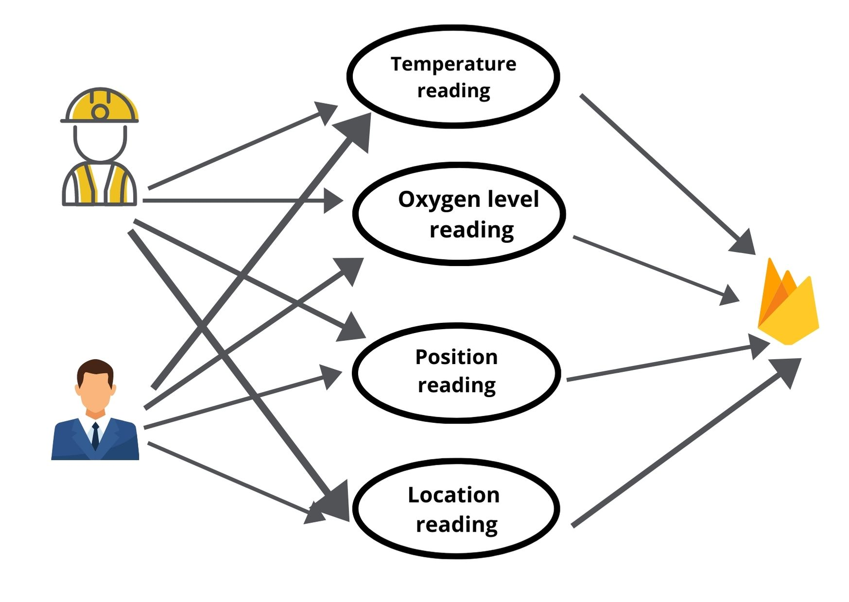
USECASE DIAGRAM
CONSTRUCTION WORKER
FIREBASE SERVER
CONSTRUCTION SUPERVISOR

Slide 12
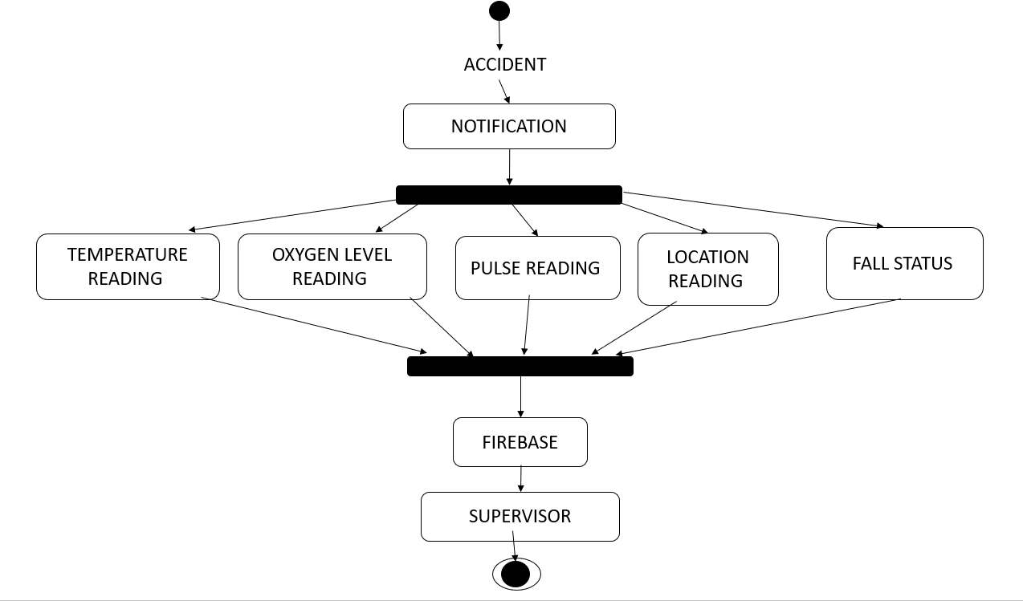
STATE DIAGRAM

Slide 13
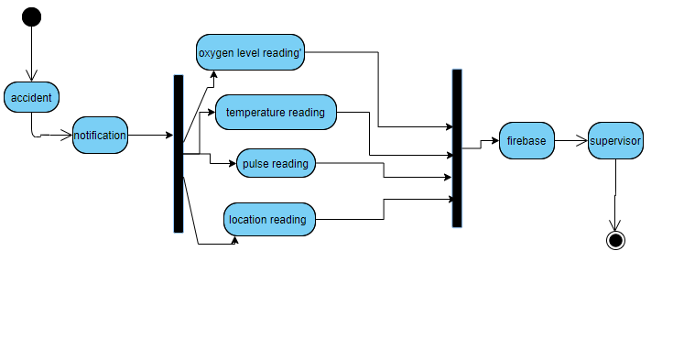
ACTIVITY DIAGRAM

Slide 14
COLLABORATION DIAGRAM
FALL STATUS
HEART RATE
3. TEMPERATURE
4. SPO2 LEVEL
5. LOCATION
CONSTRUCTION WORKER
FIREBASE SERVER
6. UPDATE DATA
CONSTRUCTION
SUPERVISOR

Slide 15
SEQUENCE DIAGRAM
USER
FIREBASE
(SERVER)
SUPERVISOR
(APP)
FALL STATUS
HEART RATE
TEMPERATURE
SPO2 LEVEL
LOCATION
UPDATE DATA

Slide 16
MODULE DESCRIPTION
There are five modules in our project .The list of modules are as follows:
Fall Detection
Temperature Sensing
Oxygen Level Sensing
Location and Position Sensing
Heart Rate Detection

Slide 17
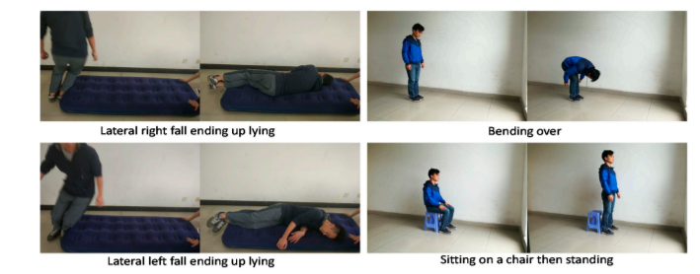
1.FALL DETECTION
This module consists of a small self-packaged sensor unit which is used to measure the angular velocity of the object and the acceleration or motion of the human body.
Continuously Monitor the Physical Condition of the Workers the accelerometer and the gyroscope are embedded inside a single chip. This chip is fixed in the kit to detect the Acceleration, Axis and gravity of the Helmet. Both these sensors are used for fall detection that may result from drowsiness, fatigue, etc.
Based on the orientation the APP automatically detects falls based on a proposed fall detection algorithm. Once the fall is detected, an alarm is issued by the mobile phone to the contractor of the site.
For our system the power supply is provided by connecting the kit to the laptop but we can attach a battery with 3.5 -5 volts in future. Thus making the device is very convenient to be carried by the users.

Slide 18
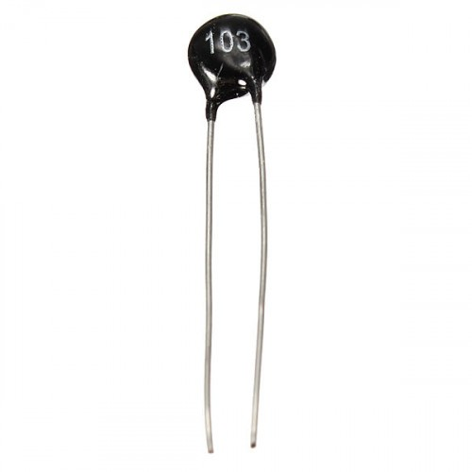
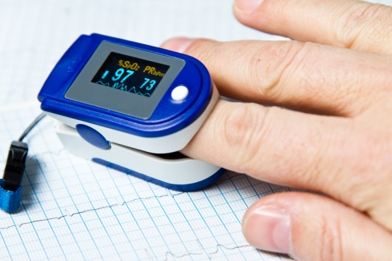
2. TEMPERATURE SENSING
The temperature sensor is used to sense the temperature of the construction worker. If the temperature goes above 37 degree Cesius, then the temperature’s status changes from normal.
Helps to determine if a construction worker is not feeling well.
3. OXYGEN LEVEL SENSING
SpO₂ is measured at the periphery, usually a finger, and is one measure of the health of the cardiovascular and respiration systems. A pulse oximeter noninvasively measures the oxygen saturation of a worker’s blood.
Will be useful in finding the worker is alive and healthy after an untoward accident.

Slide 19

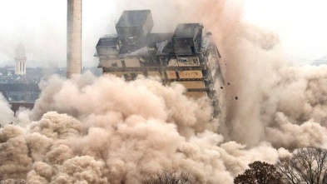

4. LOCATION AND POSITION SENSING
Location sensor to find out the location of a particular worker is present using unique ID.,
Eg: Worker ID 8266 is in 1st floor.
It also help to check in groups - The number of people working at a particular floor at a particular time.
Position sensor will be useful to determine the number of people who are stuck in event of accident.
5. HEART RATE DETECTION
Pulse monitoring sensor is used to find out the rate of heartbeat of a particular user (Construction Worker)
In a event of disaster this sensor is used to determine whether the worker is still alive or not to proceed with evacuation.

Slide 20

PERFORMANCE ANALYSIS
In the literature, there are already many works for human fall detection. To address the advantages of our method, we make a comparison with some previous methods in terms of sensor location, accuracy, portability, and comfort. Though the experiment protocols of these methods are different and the datasets for detection are based on their experiments, all of them considered the distinction between simulated falls.
Meanwhile, our system has good portability because the small sensor safety kit can easily be worn by a worker.
Our system also includes a unique feature which is the heart rate monitor which would be highly useful in determining whether the worker is alive or not in event of disaster and help in prioritizing which worker to save first during the excavation process.
The position detector would help in locating the worker in event of disaster. It would pin-point which floor the worker was in before the fall which would help us determine how many feet under he is.
The result analysis of our project includes 1) Sensing the fall of a worker , temperature, position, heart rate and oxygen level by the smart kit 2)Transmission of data using Wi-Fi to Firebase 3) Storing and monitoring data using our app.

Slide 21
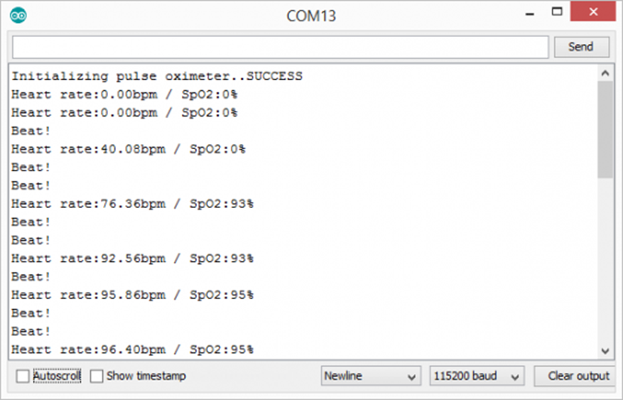
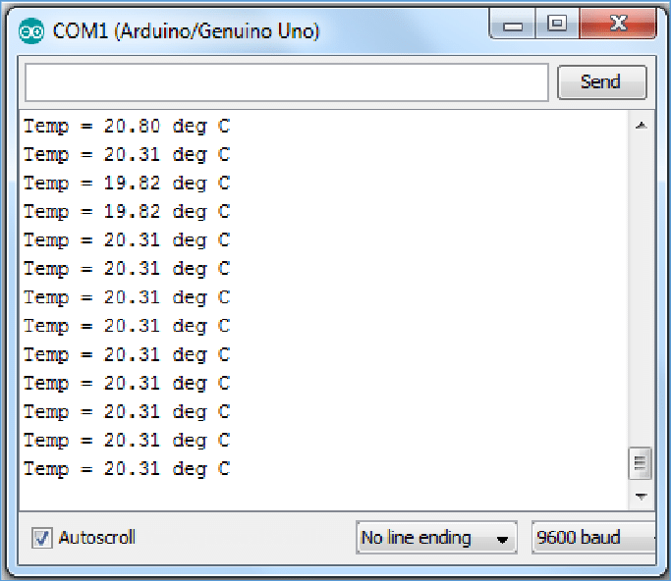
SCREENSHOTS OF WORK DONE
Pulse Oximeter Reading using MAX30100 with Arduino uno.
2. Temperature reading using LM35 with Arduino uno.

Slide 22

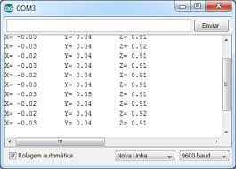
SCREENSHOTS OF WORK DONE
3. Three axis reading using ESP8266 with ADXL345.
4. Final output as shown in the Website

Slide 23
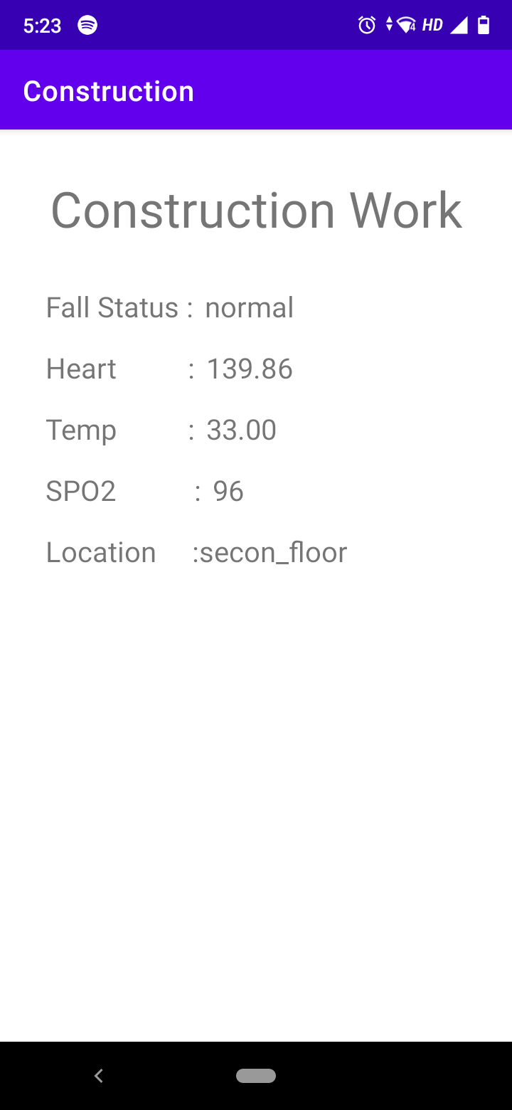
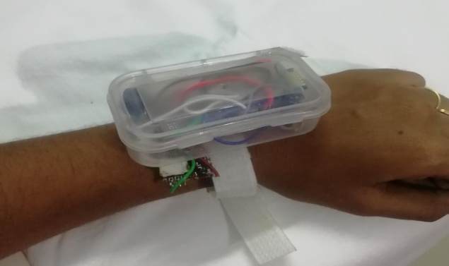
SCREENSHOTS OF WORK DONE
5. Final output as shown in the app
6. Our Safety Kit

Slide 24

CONCLUSION
If this proposed system is implemented then it would ensure the complete safety of the workers at the construction site.
Through this smart kit, the contractor can continuously monitor all the workers involved in the construction process and can also get notified about the workers’ physical condition and can immediately save the workers from any serious issues in case of emergency. Hence we can reduce the death rate of the construction workers and provides increased security to them.
This application would play an important role in rescue process at a faster pace, thus ensuring that many valuable lives are saved from the clutches of suffocation and eventual death.
Since there are no products designed with our unique features at present - to help reduce the number of deaths in the construction field, our product will be one in a kind.

Slide 25
REFERENCES
1. A Smart Helmet For Improving Safety In Mining Industry by Mrs.A.Dhanalakshmi P.Lathapriya, K.Divya.
2. Automatic Fall Detection using Smartphone Acceleration Sensor by Tran Tri Dang, Hai Truong, Tran Khanh Dang.
3. Fall Detection Based on Accelerometer and Gyroscope using Back Propagation by Adlian Jefiza1 , Eko Pramunanto , Hanny Boedinoegroho , Mauridhy Heri Purnomo.
4. Hard Hat Detection Using Deep Learning Techniques by C. Jagadeeswari, Nagamani.G, Sneha.B and Dr. G. NagaSatish.
5. Highly Portable, Sensor-Based System for Human Fall Monitoring by Aihua Mao, Xuedong Ma, Yinan He and Jie Luo.
6. IoT based Smart Helmet for Ensuring Safety in Industries by Mangala Nandhini. V , Padma Priya G.V , Nandhini. S, Mr. K.Dinesh.
7. A Smart Helmet for Air Quality and Hazardous Event Detection for the Mining Industry by Raghavendra Rao B, Karthik NS, NA Poojitha, Divya L, Nandini N.
8. Smart Helmet for Coal Miners using Zigbee Technology by Shirish Gaidhane , Mahendra Dhame & Prof. Rizwana Qureshi.
9. Smart Helmet for Coal Mines Safety Monitoring and Alerting by S. R. Deokar , V. M. Kulkarni, J. S. Wakode.
10. Zigbee based intelligent helmet for coal miners by Pulishetty Prasad , Dr. K. Hemachandran , H.Raghupathi.
11. British Safety Council opens office in India to help save lives | British Safety Council (britsafe.org)
12. British Safety Council establishes a ground-breaking forum in India for sharing best practice in health, safety and wellbeing | British Safety Council (britsafe.org)

